Slide 1
Artificial Neural Network Presenter: Aravind Prabhu Gopala Krishnan MSc. Intelligent System and Robotics P2611436 De Montfort University

Slide 2
Artificial Neural Network
Dataset
The dataset used here was KDD cup which carries information about intrusion happening in the military network.
It has 1048576 rows × 42 columns , each columns represents the data type such as list of protocols, services, login details, root shells etc. From this 41 columns are used as a input features and last column 42 carries the types of attacks happened in that network which label or output feature.
Hence labels has multiple types of attack names, hence it is a multiclass classification problem.
But here these labels are converted into binary classification by separating no attack networks as “Normal” and attacked network as attack. So now the output features carries Normal and attack which is converted to binary classification problem.

Slide 3
Data Pre-processing
Data pre-processing is also called data cleaning, the data was taken from some websites, it was created by someone have the possibility to carry some unfilled values, some similar values, or some irrelevant values.
These kind of problems reduce the performance of the neural network, so by eliminating this kind of data is called data pre-processing.
As well as the dataset carries numerical data’s, binary data’s and also categorical data. Well known computers cannot process string values.
So the first step of data pre-processing is to convert categorical data into numerical data.
This was done using pandas library in python, pandas providing a function called astype which will replace the categorical data by its index.
Second step was to drop the duplicate values, in the sense duplicate values are some values copied from different row which contains same data from previous rows.
After dropping duplicates the dataset was split into input and output features in different variable name X and Y

Slide 4
Data Pre-processing
Data was still in the CSV format, the neural network can’t process csv file, so the data was converted into matrix form using .values from python which convert each row in vector form of 2D matrix.
Then input data carries some irrelevant data’s which was wrongly enter by user or system called outliers.
This outliers were eliminated by normalising the data, the normalization was used here was taken from sklearn libraries, which helps to eliminate duplicates, outliers and also helps to maintain the correlation of each data in the rows.
After that label encoder was enabled to convert the output features in to binary values 1 and 0. This helps system in prediction step.
After pre-processing stage the dataset was split into 70% for training purpose and 30% for testing purpose.

Slide 5
Model selection
The ANN model is used here, which contains 1 output layer, 3 hidden dense layer and 1 output layer. The first hidden layer carries 128 neuron, and 2nd layer carries 64 neurons and final layer carries 32 neurons.
Each layer was connected with activation function at the output side of the each layers, the activation function used here was ReLu activation.
These activation function helps during at the time of backpropagation, where relu is mainly used for dense layered network, where other activation functions cause vanishing gradient problem.
And also these activation function introduce non-linearity to the input features, if the system was linear while doing backpropagation the integral part shows no difference with respect to loss.
The aim of model is to minimise the loss by adjusting the weight of the each neurons.
ReLu activation function makes system fast while learning, learning in the sense weight update.

Slide 6

Model Selection
Backpropagation
Backpropagation is the process happen in all neural network model, which mean each neuron in the hidden layer have their own weight updates which was initialise randomly at the beginning stage
Then each neuron weight will update using chain rule, at the end of process the output layer calculate the loss between the actual output and predicted output, this loss was calculated in our model using binary cross entropy loss.
The above function is the formula for BCE loss, where y_{i} is the actual label, p(yi) is the log probability of its being normal(1) and (1-p(y)) is the probability of being attack(0)
This loss difference was then backpropagate using chain rule with respect to each layer neurons weight up to the 1st layer neurons.
Using this system could learn the correlation of the dataset was learned by neural network and this correlation helps the neural network to classify the inputs.

Slide 7
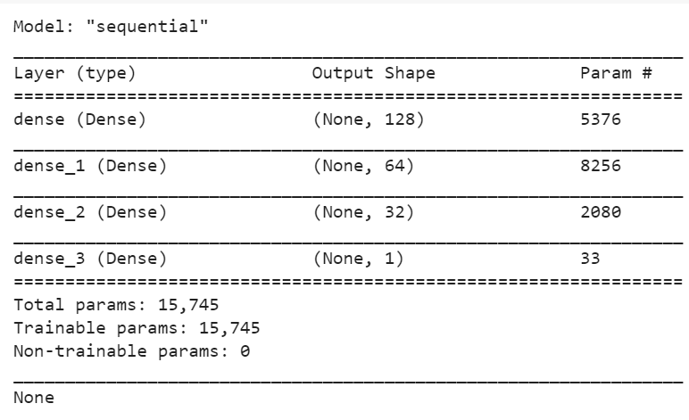
Model selection
Previous slide shows the explanation for backpropagation, in our model BP was carried out by Adam optimiser.
The reason to choose this optimiser is adoptive learning in this optimiser is good and fast, it justifies my model was learned the dataset in 11 epochs.
And it is gradient based stochastic optimisation algorithm, stochastic in the sense at the beginning of the input layer it initialize the each neuron weights randomly.
And gradient decent in the sense, our model works on the basis of minimising the loss, here loss is the gradient which tries to attain it global minimum value.
It also handles sparse data for noisy problems.
The given figure is the summary of the model, where None represents bias value which was given at the time of training.

Slide 8
Performance
Performance of the model is calculated based on training accuracy, loss, precision, recall and for testing set based on accuracy, loss and confusion matrix
The above parameters are calculated mainly using true positive, true negative, false positive and false negative.
True Positive: It is the prediction of model for number of correctly classified label ‘normal’(1) out of total labels for normal.
True Negative: It is misclassified labels for term normal(1).
False Positive: Correctly classified labels for “attack”(0).
False Negative: Misclassified labels for “attack”(0).
Based on the above terms was calculated using formula:
Accuracy: TP + TN/TP + TN + FP + FN

Slide 9
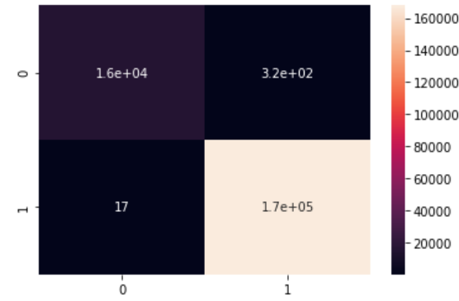
Performance
Precision: TP/TP+FP
Recall: TP/TP+FN
Attained value by system is in training phase is 99.82% Accuracy, 99.81% precision, 99.9% recall, loss 0.0153 and also validation also used while training which contains 20% of training data.
Validation set results in 99.82% accuracy, 99.82% precision, 99.9% recall and loss is 0.0129, which justifies the training performance.
And in the testing side shows 0.025 loss and 99.82% accuracy. And confusion matrix for testing set is shown in the fig.
Confusion matrix results 1.6e+04 correctly classified 0’s which in term is attacks and 1.7e+05 correctly classified 1’s which in terms are normal.
And also it failed to classify 17 attacks and 320 normal networks.

Slide 10
Conclusion
The above slides justifies the architecture of the model used in this assignment and performance shown by the model was good.
In future, further improvement will be implement and use the model for multiclassification problems.
In recent days, increase of population also increasing the collection data’s. So there is wide range of data’s available in internet today.
In my belief these huge data availability leads to huge development in technological side to maintain data’s, to use the data for different level test’s, like that this model used one type of dataset from the internet for testing my model to understand the learning process of the neurl network.

